Slide 1
Hello Elixir!
Sameeri Marryboyina

Slide 2




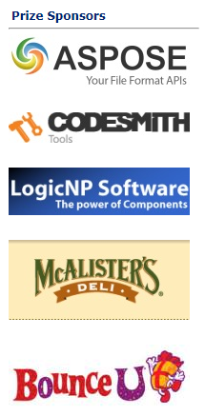


Thank you sponsors

Slide 3


Thank you TECHLAHOMA!
OKC Elixir
OKC FP
Find Techlahoma on all things social.

Slide 4

Talk Agenda
Target Audience
About Me
Foundations
The road to Elixir (How I met Elixir!)
Elixir

Slide 5
TARGET AUDIENCE

Slide 6
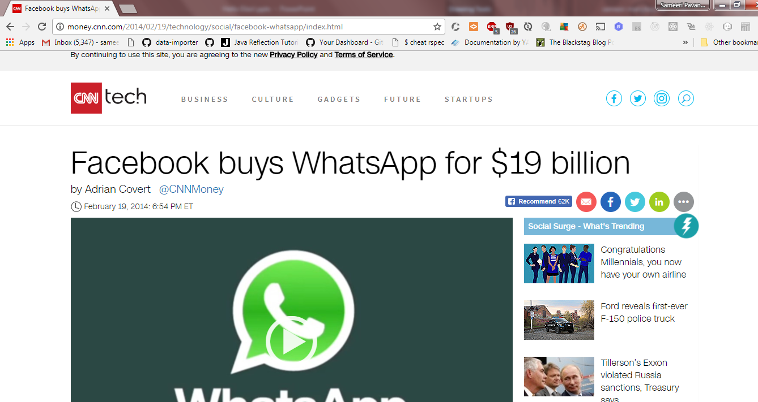
Talk PITCH

Slide 7
The whatsapp story
WhatsApp, was incorporated in 2009 by Brian Acton and Jan Koum, both former employees of Yahoo! . After Koum and Acton left Yahoo! in September 2007, the duo traveled to South America as a break from work.^{[18]} At one point they applied for jobs at Facebook but were rejected.^{[18]} For the rest of the following years Koum relied on his $400,000 savings from Yahoo!. In January 2009, after purchasing an iPhone and realizing that the App Store would soon create an industry of apps, Koum started visiting his friend Alex Fishman in West San Jose where the three would discuss ".... having statuses next to individual names of the people", but this was not possible without an iPhone developer. Fishman found a Russian developer on RentACoder.com, Igor Solomennikov, and introduced him to Koum. Koum named the app "WhatsApp" to sound like "what's up". On February 24, 2009, he incorporated WhatsApp Inc. in California. However, because early versions of WhatsApp often crashed or got stuck at a particular point, Koum felt like giving up and looking for a new job, upon which Acton encouraged him to wait for a "few more months". - Wikipedia

Slide 8
What this talk is not!
This talk is not entirely about how to code in Elixir!

Slide 9
What this talk is about
“This talk is a story!”

Slide 10
ABOUT ME

Slide 11
Hello, sameeri.
Sameeri Pavan Kumar Marryboyina
Hyderabad, India
I can communicate in Telugu, Hindi, English, German(very little)
MS in Computer Science, The University of Oklahoma
Senior Software Engineer, Telogical Systems LLC
Full Stack JS - React, Redux and its Ecosystem, Node, Express
Norman, OK

Slide 12
India
Let us travel to Sameeri’s home..
https://www.google.com/maps/place/India/@18.2937219,71.4458457,5z/data=!4m5!3m4!1s0x30635ff06b92b791:0xd78c4fa1854213a6!8m2!3d20.593684!4d78.96288

Slide 13
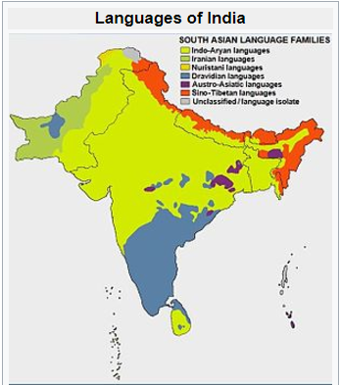
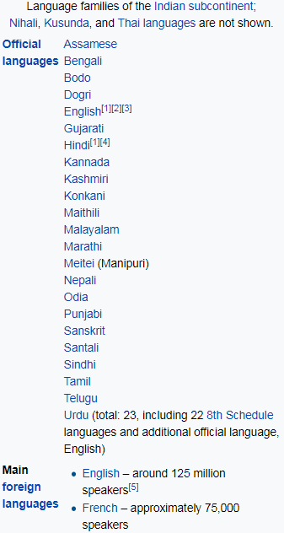
source : https://en.wikipedia.org/wiki/Languages_of_India

Slide 14
Family
Dad – Our German and English Teacher
Brother – German, Spanish. Interested in Japanese, Italian, Korean
Mom – Was a Telugu lecturer at a college.

Slide 15
FOUNDATIONS

Slide 16
Being a polyglot...
WORK | SCHOOL | LEARNING | RADAR
JavaScript | C | Elixir | Elm
C# | C++/VC++ | Erlang | TypeScript
Ruby | COBOL |  | Python
Java | Assembly |  | Scala
 |  |  | Rust
 |  |  | Go

Slide 17

But, What does it mean to be a Language?

Slide 18
What kind of a problem are we trying to solve?
A language is a tool.
Problems and Contexts
We want to use the right tool for a given problem
Communication

Slide 19
A Language…
Alphabet
Constructs
Syntax
Semantics
Type System (Static vs Dynamic)
Translation Model (Compiled vs Interpreted)
Execution model
Runtime Mechanics
Specification
Implementation

Slide 20
Language tools
Editor
Compiler
REPL
Virtual Machine
Debugger
Standard Library
Dependency Management
Build tool
Workflow tools based on processes – Tests, Coverage, Syntax highlighting, Refactoring…

Slide 21
Inside the head of a software engineer
Language Syntax
Types
Philosophy
Paradigms
Standards/Best Practices
Principles
Patterns
Problem + Context
Crafting solutions

Slide 22
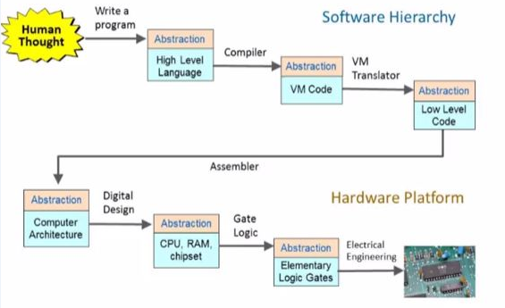
The process – From Human thought to something magical
source : http://www.nand2tetris.org/

Slide 23
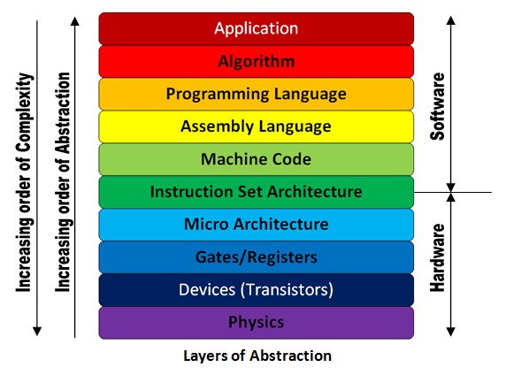
The Machine stack – Layers of Abstraction
source : http://theembeddedguy.com/2016/05/15/layers-of-abstraction/

Slide 24
Language translation
TRANSLATOR
SOURCE
LANGUAGE
TARGET LANGUAGE
Based on the language, its philosophy, the translator could be called anything. Say, compiler for instance.
A very important observation to make in the context of language translation is whether we can observe the
Generation of an intermediary file or not. This also defines the execution/runtime mechanics.

Slide 25
Modern languages
Roughly after 1985.
Memory should be managed automatically. aka Garbage Collection
Provision of higher level abstraction constructs.
The concept of a runtime, intermediary language => Virtual Machine
Developers Psychology - Discovery of patterns and anti patterns, How to write good/clean code?

Slide 26
VIRTUAL MACHINES
Source
Portability
The notion of Intermediary Language
Multiple Languages targeting the VM.
Defines execution semantics
Intermediary
Translation process
VIRTUAL MACHINE
RUNTIME ROLE

Slide 27
Familiar virtual machines
Java World : Java Virtual Machine (JVM)
.NET World: Common Language Runtime (CLR)

Slide 28
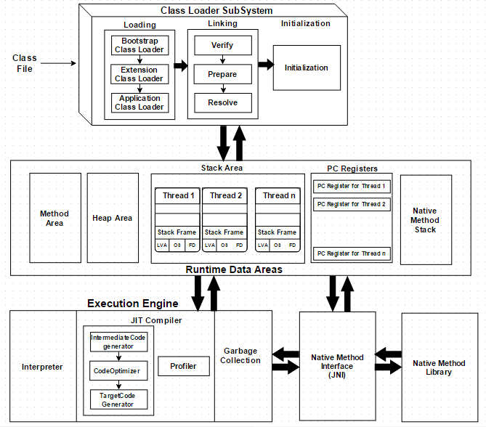
JVM

Slide 29
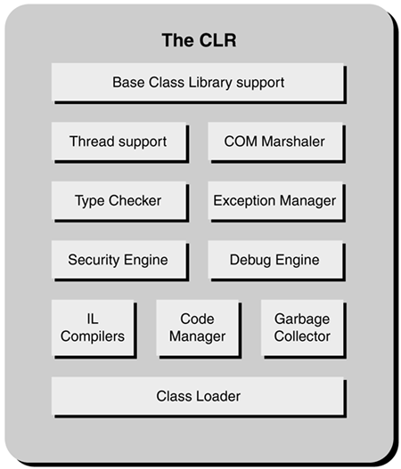
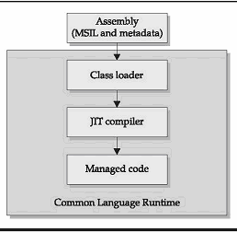
CLR

Slide 30
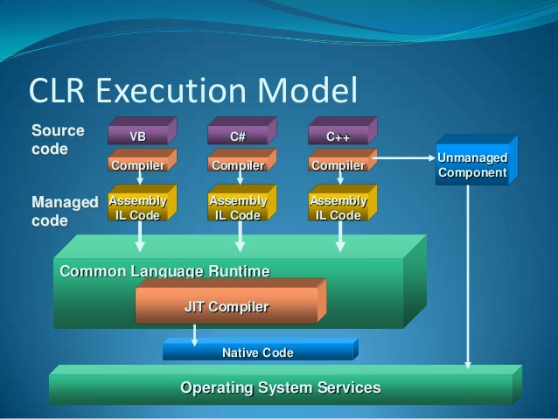
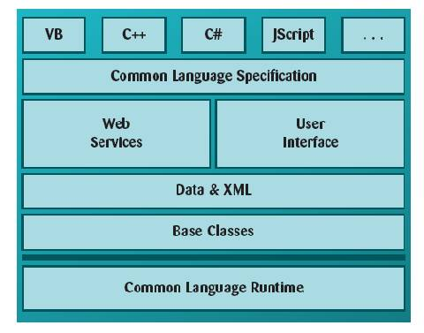
The power of an intermediary language & VM
Multiple languages can now target the intermediary language. They can also all use the
Services that the runtime has to offer. A high degree of reusability.

Slide 31
Where does the OS FIT IN?
VM/Runtime is all good.
But…
The fundamental way to run a program is via the OS.
All hail the OS!!

Slide 32
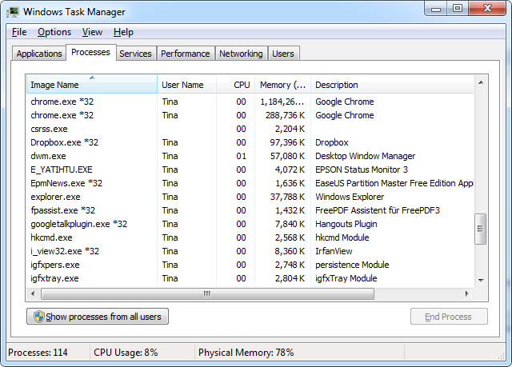
Operating system constructs
Process
Thread
Concurrency
Context Switching
Schedulers
Scheduling Algorithms
The user is tricked. But that is good.
Everyone loves Magic!

Slide 33
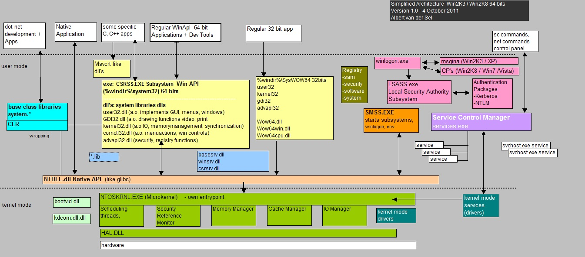
Operating system OPERATION

Slide 34
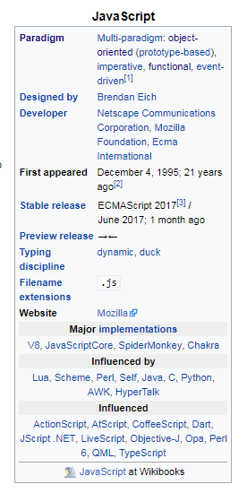
How languages s each other
Languages influence one another.
That means language designers(people) are constantly trying to improve the language
They do this by exploring other languages/environments trying to find good ideas and bring them aboard.

Slide 35
Thoughts on languages
I consider language as a tool, method to communicate our thoughts.
Since it is a tool, it is a matter of preference.
But, People are highly opinionated.
People are programmed to think in one way, when they are in one environment.
If we step out, we will find commonalities and find love for the language.
Studying a lot of languages help us grow and think better.
Languages are mostly multi-paradigm. That means we have a lot of thinking hats to put on and find the best way to solve a problem.
We should continuously discover and enjoy
Tooling is very important to build products quickly.
Tooling has a “happy developer factor” associated with it.
We should invest time in learning and learning is continuous.
We should try to craft clean code.

Slide 36

The road to elixir…

Slide 37
Core LEARNING interests
Distributed Systems
Event Oriented Architecture
Message Oriented sytems
Highly scalable systems
Reactive Architectures
“All the vocabulary is great! How should we learn these? What’s the plan?” I said to myself.

Slide 38
The bus
Service Bus
Enterprise Service Bus
Message Bus
I encountered a lot of terms.
I worked on NServiceBus in my .NET days!

Slide 39
What does it mean to be a distributed system?
The 8 Fallacies of Distributed Computing
https://en.wikipedia.org/wiki/Fallacies_of_distributed_computing
Networks
Interprocess communication
Communication, Collaboration, Coordination.
Application integration

Slide 40
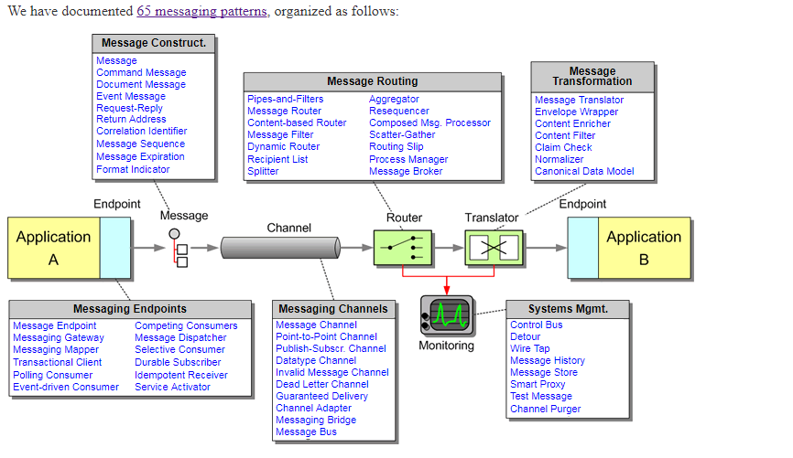
Integration patterns
http://www.enterpriseintegrationpatterns.com/patterns/messaging/

Slide 41
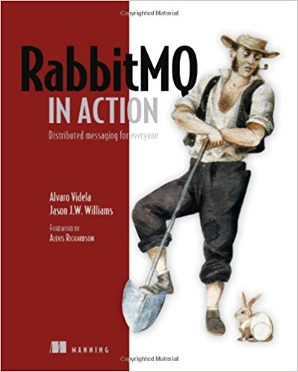
RABBITMQ ADVENTURES
AMQP
RabbitMQ history
RabbitMQ Constructs
RabbitMQ examples/patterns
https://www.rabbitmq.com/getstarted.html

Slide 42
ERLANG

Slide 43
The history of Erlang
Ericsson
Problem context
The CS lab/team
Solution Approach - RESEARCH -“Investigate the right programming language/environment for the given problem.”
1982-85: “Experiments with programming of telecom using > 20 different languages. Conclusion: The language must be a very high level symbolic language in order to achieve productivity gains ! (Leaves us with: Lisp , Prolog , Parlog ...)”
1985-86: “Experiments with Lisp,Prolog, Parlog etc. Conclusion: The language must contain primitives for concurrency and error recovery, and the execution model must not have back-tracking. (Rules out Lisp and Prolog.) It must also have a granularity of concurrency such that one asyncronous telephony process is represented by one process in the language. (Rules out Parlog.)”
Conclusion: “We must therefore develop our own language with the desirable features of Lisp, Prolog and Parlog, but with concurrency and error recovery built into the language.”
Source: https://www.erlang.org/course/history

Slide 44
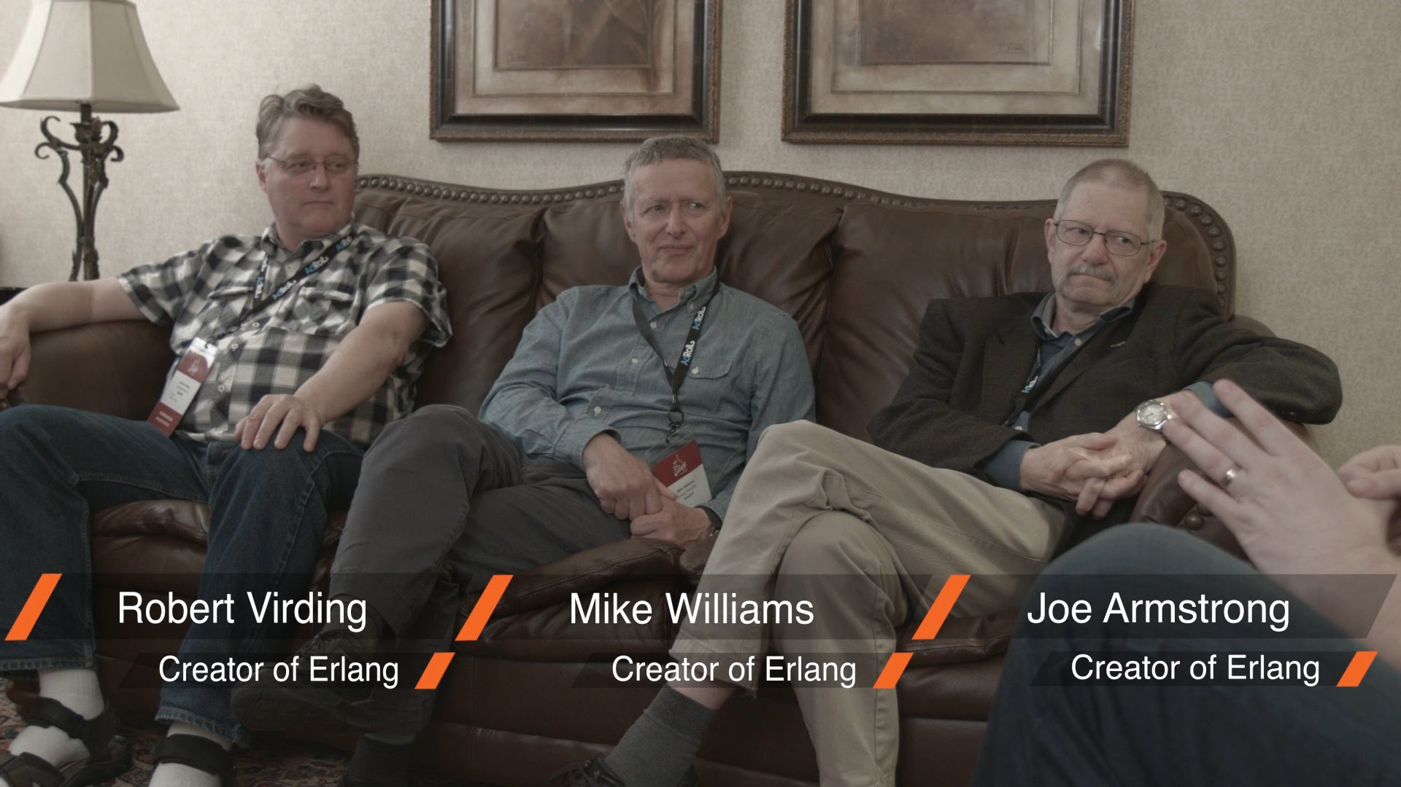
Lets meet the people
“Develop our own language with the desirable features of Lisp, Prolog and Parlog,
but with concurrency and error recovery built into the language.”

Slide 45
Implementation
1987-93
The notion of an “Abstract Machine” borrowed from Prolog.
Joe’s Abstract Machine
Improve implementations through the years.
Abstract Machine = Virtual Machine
The Erlang Virtual Machine aka BEAM
BEAM –

Slide 46
ERLANG OTP - Other amazing thoughts
Discover best practices, patterns
Develop a set of tools.
“OTP was originally meant to be – Open Telecom Platform”
Coined during the age when “Open” was a common day-day use by Engineers.
“OTP is set of Erlang libraries and design principles providing middle-ware to develop these systems. It includes its own distributed database, applications to interface towards other languages, debugging and release handling tools.” – Erlang site

Slide 47
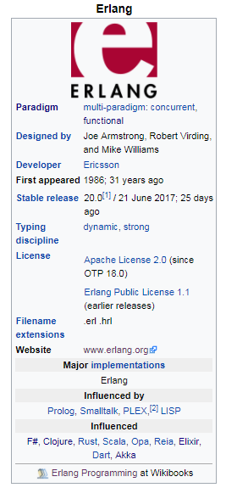
ERLANG

Slide 48
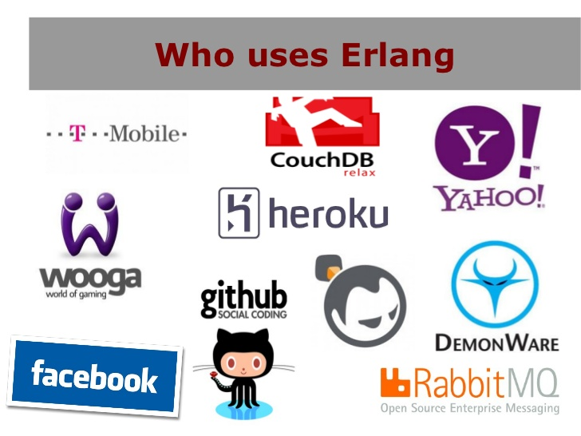
What problems does it solve?
“By understanding who uses Erlang, we can understand the kinds of systems!”

Slide 49
Systems that are basically..
“Massively scalable soft real-time systems with requirements on high availability”
“Some of its uses are in telecoms, banking, e-commerce, computer telephony and instant messaging.” – Erlang site
Concurrent software, high level Concurrency

Slide 50
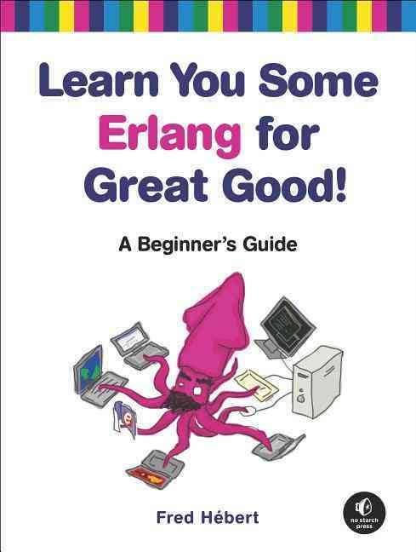
ACTor model
“Erlang uses the actor model, and each actor is a separate process in the virtual machine.” – The book

Slide 51
Actor model
A model. Not a library. Not a technology.
It is a way of thinking about “Computing”
The actor model in computer science is a mathematical model of concurrent computation that treats "actors" as the universal primitives of concurrent computation. - Actor Model, Wikipedia
The actor model originated in 1973.^{[1]} It has been used both as a framework for a theoretical understanding of computation and as the theoretical basis for several practical implementations of concurrent systems. - Actor Model, Wikipedia

Slide 52
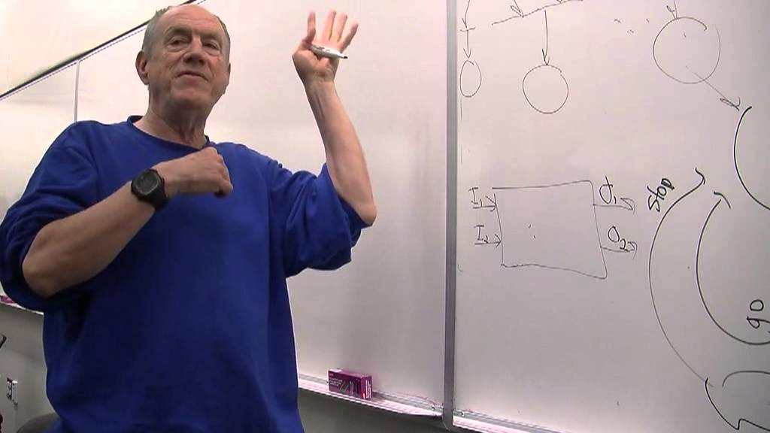
Carl hewitt
“Carl Hewitt explaining the Actor model” - https://www.youtube.com/watch?v=7erJ1DV_Tlo&t=761s

Slide 53
Carl Hewitt speaks
According to Carl Hewitt, unlike previous models of computation, the actor model was inspired by physics, including general relativity and quantum mechanics. It was also influenced by the programming languages Lisp, Simula and early versions of Smalltalk, as well as capability-based systems and packet switching.
Its development was "motivated by the prospect of highly parallel computing machines consisting of dozens, hundreds, or even thousands of independent microprocessors, each with its own local memory and communications processor, communicating via a high-performance communications network."^{[2]} Since that time, the advent of massive concurrency through multi-core and manycore computer architectures has revived interest in the actor model.

Slide 54
ACTOR MODEL
The actor model adopts the philosophy that everything is an actor.
This is similar to the everything is an object philosophy used by some object-oriented programming languages.
An actor is a computational entity that, in response to a message it receives, can concurrently:
send a finite number of messages to other actors;
create a finite number of new actors;
designate the behavior to be used for the next message it receives.
There is no assumed sequence to the above actions and they could be carried out in parallel.
Decoupling the sender from communications sent was a fundamental advance of the Actor model enabling asynchronous communication and control structures as patterns of passing messages.[8]
Recipients of messages are identified by address, sometimes called "mailing address". Thus an actor can only communicate with actors whose addresses it has. It can obtain those from a message it receives, or if the address is for an actor it has itself created.
The actor model is characterized by inherent concurrency of computation within and among actors, dynamic creation of actors, inclusion of actor addresses in messages, and interaction only through direct asynchronous message passing with no restriction on message arrival order.

Slide 55
Erlang revisited
TWO PARTS TO ERLANG
Sequential Programming
Concurrent Programming

Slide 56
Concurrency oriented programming
Concurrency is key in the language.
The language needs to provide ‘constructs’ to support concurrency!
Erlang constructs are called ‘processes’.
Processes communicate with each other by passing messages to one another.
To achieve concurrency, “schedulers” are in place.

Slide 57
Does that mean erlang was implementing carl Hewitt’s actor model?
NO.
Sweden vs US
No Web at the time.
It just maps neatly! That is all.
“We did not know about the Actor model then.” – Joe Armstrong

Slide 58



Slide 59
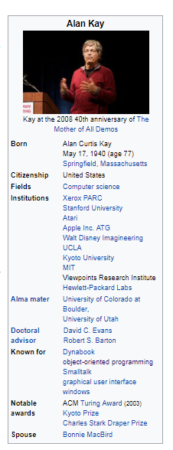
Alan kay
“I made up the term 'object-oriented', and I can tell you I didn't have C++ in mind”
-- Alan Kay, OOPSLA '97

Slide 60
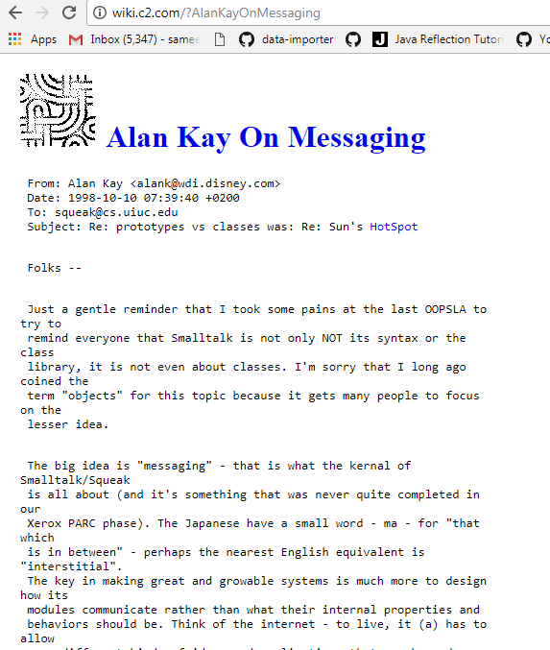
Alan kay on Object orientation
“The big idea is messaging” – Alan Kay

Slide 61
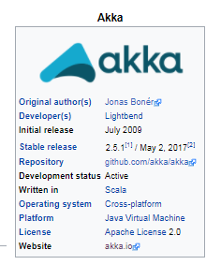
AKKA
“Akka is a free and open-source toolkit and runtime simplifying the construction of concurrent and distributed applications on the JVM. Akka supports multiple programming models for concurrency, but it emphasizes actor-based concurrency, with inspiration drawn from Erlang.” – Akka, Wikipedia
http://akka.io/, http://getakka.net/

Slide 62
Jose valim

Slide 63
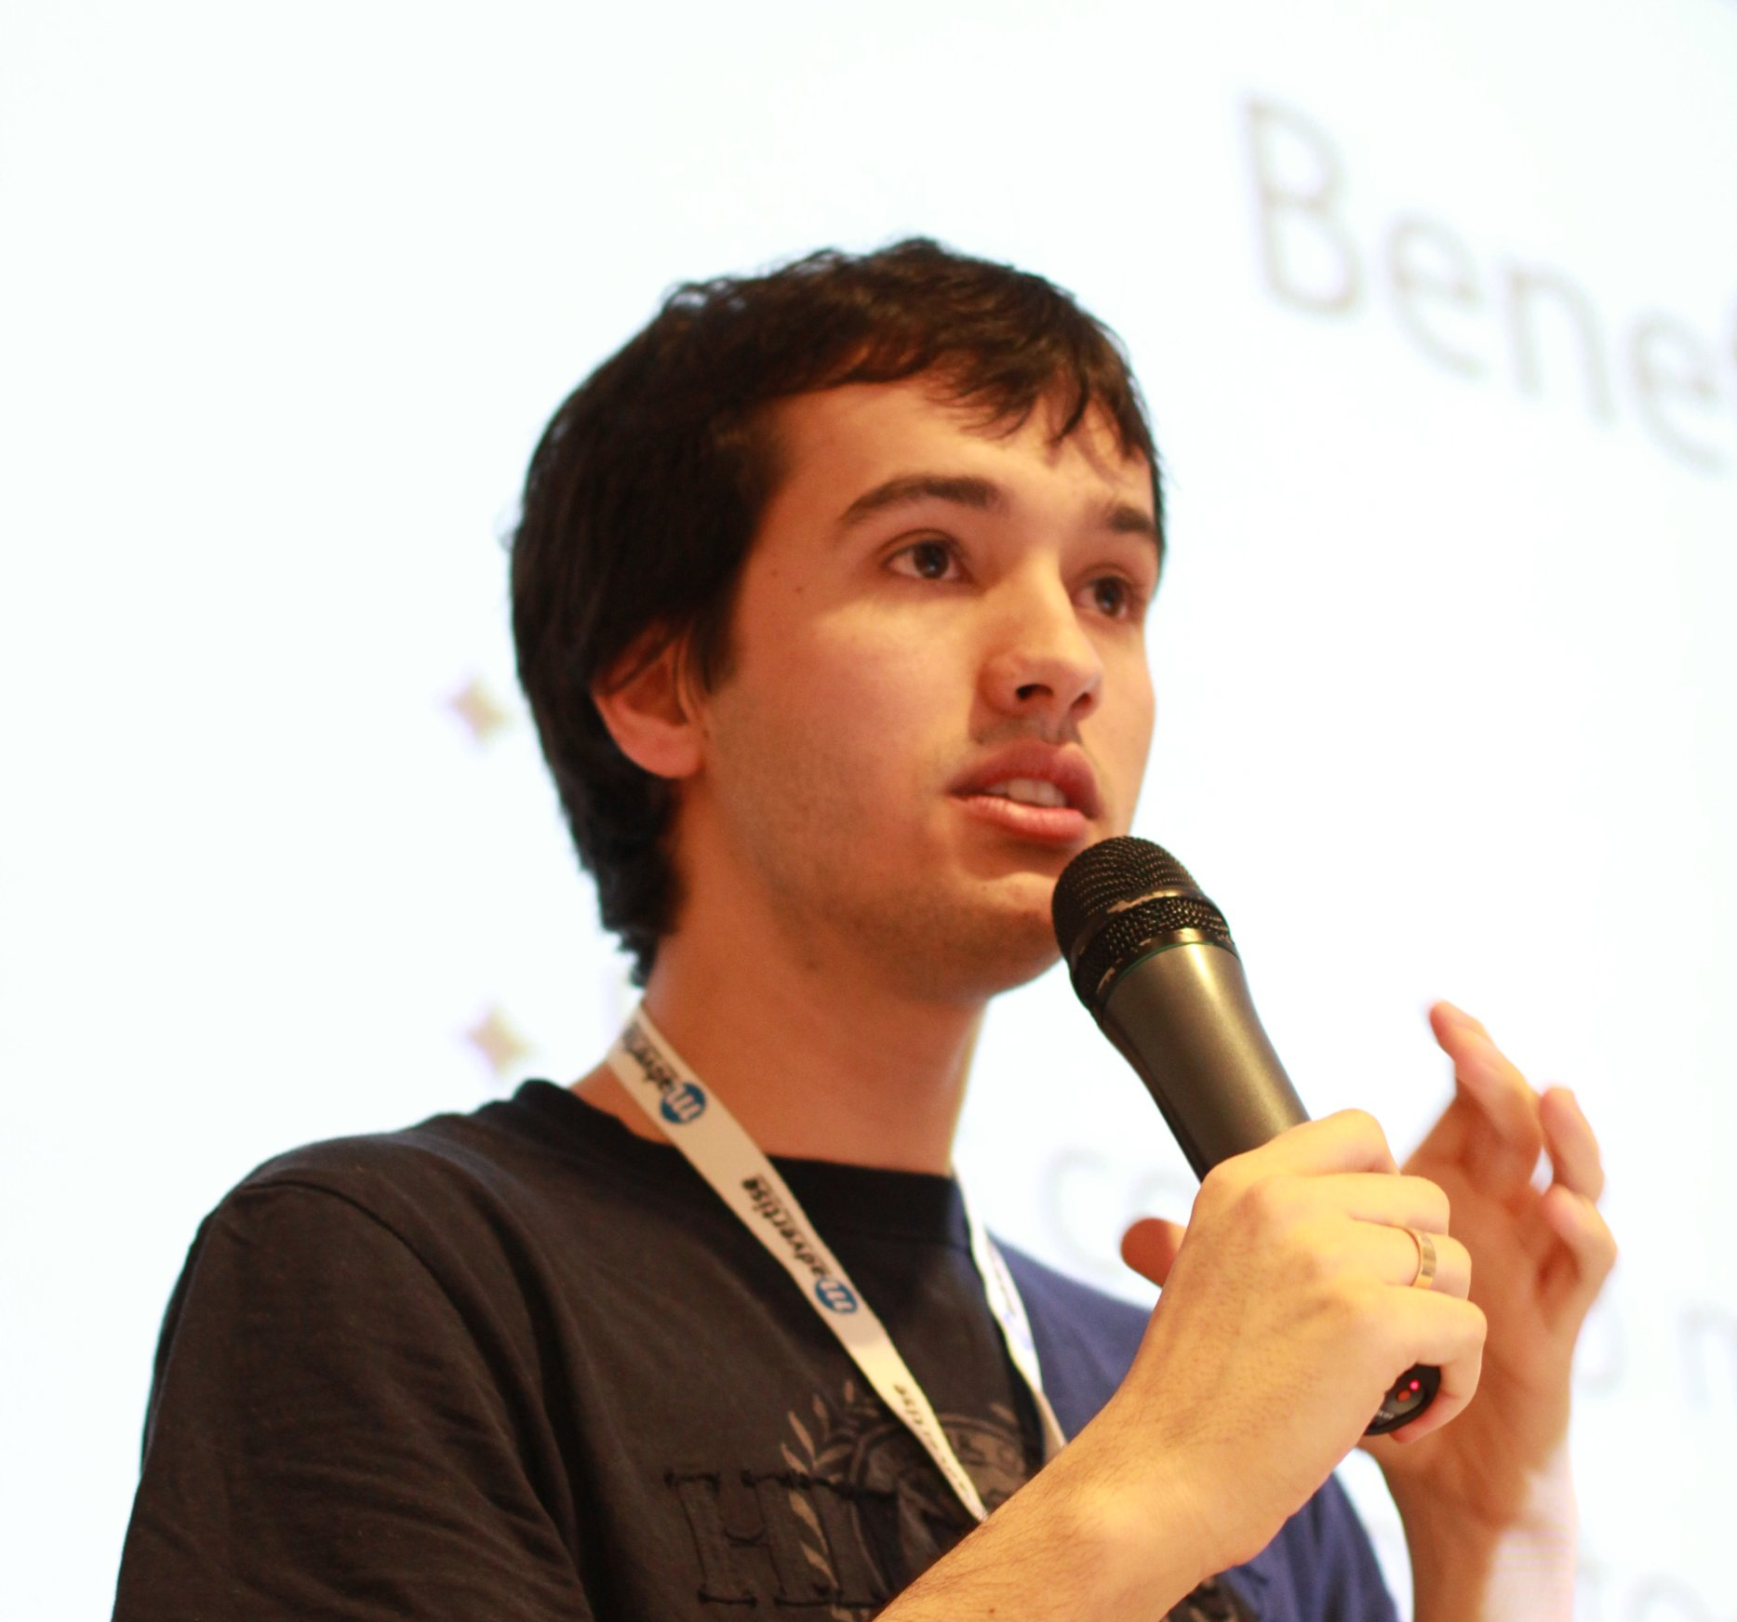

Say hi to jose valim
RUBY ON RAILS CORE CONTRIBUTOR

Slide 64
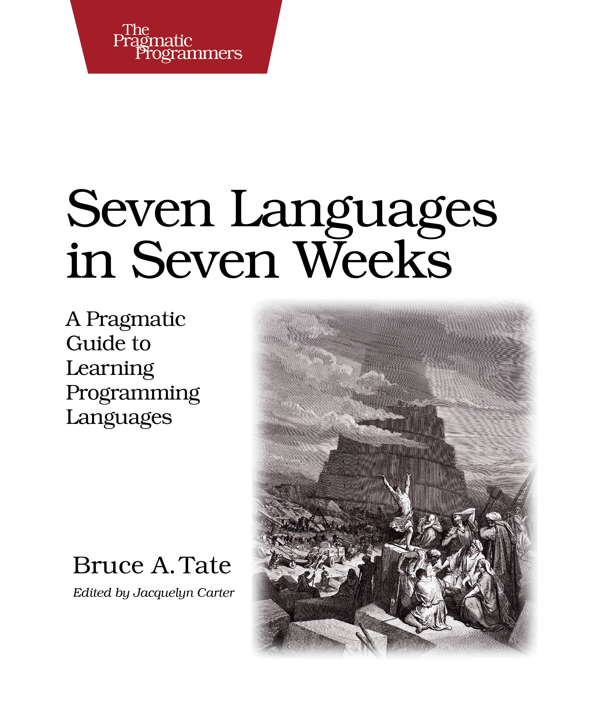
I need “High performant software” - jose

Slide 65
In Love with erlang
Jose loves the technology!
He loves the concepts!
He chooses to adopt the “Erlang VM” to his toolset.
But after sometime…
Starts thinking hard!
I need better tooling.
I need a better syntax.

Slide 66
Elixir

Slide 67
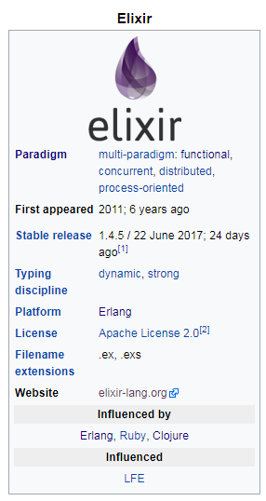


Slide 68
Elixir
Built on top of the Erlang VM
Modern syntax
Aggregated ideas from various programming languages.
Interoperable with Erlang code.
All benefits from OTP free.
Builds on top of Erlang constructs and provides cleaner abstractions.
Amazing tooling.
Sophisticated ecosystem.
Awesome community.

Slide 69
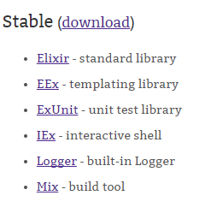
Elixir distribution
Tools – elixir, elixirc, iex
Standard Library
Mix – The comprehensive build system : Best practices, code organization, code generation
Hex – Package Management
ExUnit – Unit testing
ExDocs – Documentation

Slide 70
Elixir in action…

Slide 71
Agenda
Understand Elixir dependencies
Distribution - Observe files on the disk
Iex
:observer

Slide 72
CODE CONSTRUCTS
`String.length/1` will take longer as the input grows.
Module
Function
The |> operator
Data – Atoms, Tuples, Lists, Maps, Binaries, Strings, Char lists, Keyword lists
Pattern Matching
‘=‘ does not mean assignment. It means binding.
Reading docs

Slide 73
Modules
Modules are code organization units
We can have nested modules
Nested Modules have

Slide 74
Functions
Belong to a Module
You can have private and public functions
def, defp
String.length/1

Slide 75
THE POWER OF ELIXIR
Utilizing the Erlang VM
Agent, GenServer, Supervision
Metaprogramming (Using Abstract Syntax Tree as code)

Slide 76
CODE EXAMPLE
mix –help
mix new

Slide 77
ECOSYSTEM

Slide 78
Resources to learn elixir
https://github.com/sameeri/Hello-Elixir

